Slide 1
CAMERA ENFORCEMENT VS. SOUND ENGINEERING PRACTICES
The Clash of Diametrically Opposed Forces!
By Chad Dornsife, Executive Director
Best Highway Safety Practices Institute
Institute of Transportation Engineers
District 6 Annual Meeting
Palm Desert, CA. July 15, 2002
(3 slides added September 4, 2008)
www.bhspi.org

Slide 2
Red Light Cameras Dependant on Unsafe Practices
Camera Enforcement: A camera system’s vetting process by definition requires that a quantified engineering defect be identified and then, by design, remain uncorrected.
The larger the identified engineering defect, the more the system operators are financially rewarded for unsafe practices and negligence.
Cameras do not reduce accidents caused by engineering defects and at most locations their presence has actually caused accident rates to increase.
www.bhspi.org

Slide 3
Engineering Solution: Before Red Light Cameras
November 1980 – "The results in Table 3 show that the extension of yellow duration reduced the frequency of potential conflicts in all cases studied." ["The Influence of the Time Duration of Yellow Traffic Signals on Driver Response", Stimpson/Zador/Tarnoff, ITE Journal, Institute of Transportation Engineers, November 1980, page 27]
"It has frequency been claimed that if the yellow is "too long," more drivers will use part of the yellow as green. More drivers - it was argued - would cross after the yellow onset with long [RATHER] than with short yellow."........"The data show that the percentage of last-to-cross vehicles clearing the intersection (T+0.2) seconds or more past the yellow onset was not appreciably changed by the extension of the yellow phase."
www.bhspi.org

Slide 4
Engineering Solution: Before Red Light Cameras
Engineering Solution: Before Red Light Cameras
"The percentages of these vehicles, that is of vehicles that could have been involved in a conflict with cross-street traffic, were substantially smaller at both sites and under all conditions after the yellow duration was extended. No evidence was found at either site, under any of the conditions, that the vehicles that were in potential conflict with cross-street traffic with the extended yellow would have cleared the intersection earlier in the cycle if the yellow had not been extended…”
“Thus, the extensions of yellow duration employed in this study substantially reduced the frequency of potential intersection conflicts."
www.bhspi.org

Slide 5
Engineering: Best Practice
1988 MUTCD - Requirements of Traffic Control Devices defined:
To be effective, a traffic control device should meet five basic requirements:
1.) Fulfill a need.
2.) Command attention.
3.) Convey a clear, simple meaning.
4.) Command respect of road users.
5.) Give adequate time for proper response.
[Manual on Uniform Traffic Control Devices (MUTCD), Part 1 GENERAL PROVISIONS, SECTION 1A-2, "Requirements of Traffic Control Devices", FHWA, 1988, page 1A-1]
www.bhspi.org

Slide 6
Engineering: Prior Law before Cameras
1988 - Manual on Uniform Traffic Control Devices by FHWA contained the following provisions for traffic signals:
Section 4B-20 Signal Operations Must Relate to Traffic Flow
Traffic control signals shall be operated in a manner consistent with traffic requirements.
Data from engineering studies shall be used to determine the proper phasing and timing for a signal. Since traffic flows and patterns change, it is necessary that the engineering data be updated and re-evaluated regularly. To assure that the approved operating pattern including timing is displayed to the driver, regular checks including the use of accurate timing devices should be made.
Sidebar: Removed by the USDOT in 2000 to facilitate automated enforcement and curtail the growing number court challenges to cameras. By removing factual foundations and periodic review, signal timing no longer had any adequacy standards to be met. We believe this violates Congress’, factual basis, safety mandate for all traffic control in the Nation.
www.bhspi.org

Slide 7
Engineering: What We Know
1993 - Institute of Transportation Engineers (ITE):
Speed Zone Guidelines - A Recommended Practice
"3. Rationale for Consistent Speed Zone Guidelines - .... A third rationale is the need for consistency between the speed limit and other traffic control devices. Signal timing and sight distance requirements, for example, should be based on the prevailing speed of traffic. If these values are based on a speed limit that does not reflect the prevailing speed of traffic, safety might be compromised." ........
"4. Recommended Practice - .... It is recommended that the engineering study include an analysis of the current speed distribution of free-flowing vehicles. It is further recommended that the speed limit within speed zone be set at the nearest 5 mph increment to the 85th percentile speed or the upper limit of the 10 mph pace."
www.bhspi.org

Slide 8
Engineering: What We Know
We have the knowledge; all we need to do is apply it. Since the 1930’s, it’s been known that large numbers of violators are more often than not caused by engineering problems, rather than an out-of- control motoring public. “What we know” in 1989 FHWA paper referencing a 1930’s finding;
“In general, motorists’ noncompliance is indicative of a problem. The problem may be due to some failing on the part of the traffic engineers or the lack of understanding of the driver, but seldom is the problem a wanton disregard of the law by the motoring public.”
www.bhspi.org

Slide 9
Engineering: Best Practice
Under the statutory requirements of federal law, they are also required to apply nationally accepted practices as recognized by the Institute of Transportation Engineers (ITE), FHWA et al, not personal opinion or local practice.
Within the statutory national standards there use to be a professional legal requirement to address a wrong. It was called “Notice of Defect”.
1983, FHWA, Traffic Control Devices Handbook:
"Notice of Defect ” An agency has a duty to correct a dangerous condition when that agency has actual or "constructive" notice of the hazard.
Sidebar: Sadly the ITE too has succumbed to politics and the special interest within the USDOT. It’s an irrefutable fact that basing signal timing on posted limits that do not reflect the actual speeds of traffic is an extremely unsafe practice. Nonetheless, the ITE has now stopped referencing the “Notice of Defect” requirement altogether, and abandoned the prior best practice that signal timing must meet the needs of traffic standard. The dichotomy of the new ITE standard for signal timing, the yellow intervals adequacy can be based on an invented number established by whim and local political decree, in a National Standard that requires Uniformity?
www.bhspi.org

Slide 10
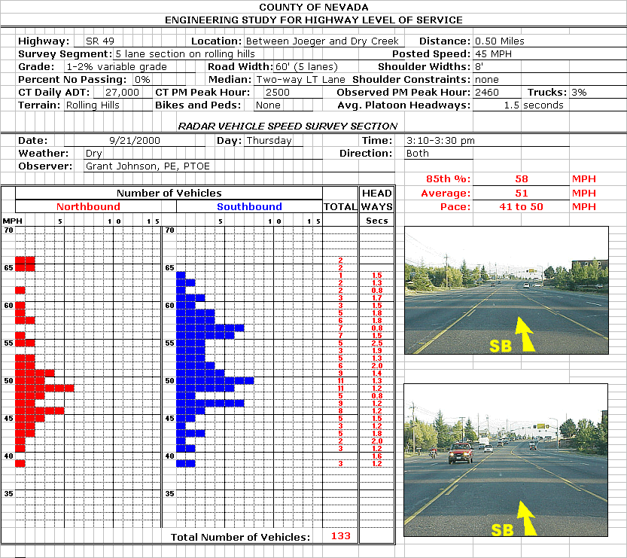
Traffic Control (signal timing) Not Set Properly Limit 45 & 65 mph Traffic = Unsafe Practice
Known Traffic Approach Speeds (prevailing) 20 MPH Greater than Posted Limit
Known Traffic Approach Speeds (prevailing) 20 MPH Greater than Posted Limit
www.bhspi.org

Slide 11
Traffic Control (signal timing) Not Set Properly Limit 45 & 65 mph Traffic = Unsafe Practice
Signal Timing Set 20 MPH Below Prevailing Speeds
45 MPH Setting / Inadequate Yellow and Warning
Known Traffic Approach Speeds (prevailing) 20 MPH Greater than Posted Limit
www.bhspi.org

Slide 12
Engineering: Best Practice
Designing for prevailing conditions is critical. There is a definite symbiotic relationship between the public’s consensus as to what is reasonable and prudent (85-90th percentile of free-flowing traffic - safest speed) and ensuring that all traffic control devices are set to safely manage the traffic’s requirements, as found, for that particular location.
The traffic engineering study quantifies this publics’ safe for conditions consensus and becomes the critical design guidance for all traffic control decisions. This is a Title 23 Federal Code of Regulations statutory minimum requirement, applying only approved nationally accepted practices and all actions and the engineer’s rationale for the solution applied and findings shall be documented.
In all studies, designing for prevailing conditions has been shown to be the most effective practice in reducing accident rates.
www.bhspi.org

Slide 13
Engineering: What We Know
In both speed limits and signal timing the engineering study quantifies the bell curve of driver actions as found for that particular location.
Changing the number on a speed limit sign WILL NOT CHANGE traffic speeds.
Shortening or lengthening the duration of the Yellow interval WILL NOT CHANGE the last to cross driver reactions or times.
www.bhspi.org

Slide 14
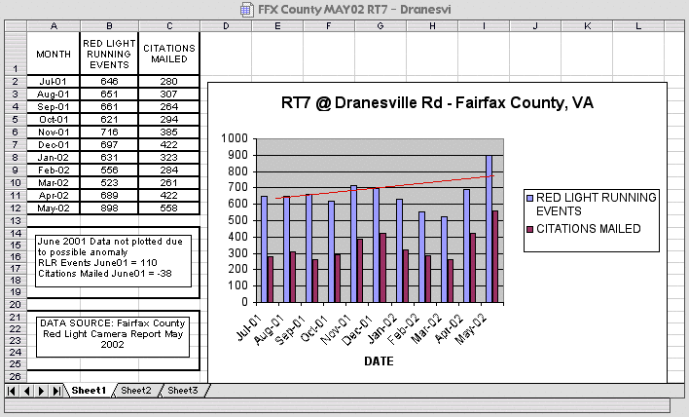
Cameras Do Not Improve Compliance: The Cameras themselves have Documented either Increases or No Reduction
www.bhspi.org

Slide 15
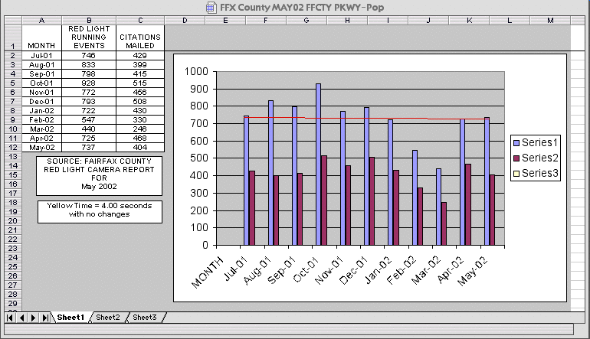
Cameras Do Not Improve Compliance: The Cameras themselves have Documented either Increases or No Reduction
www.bhspi.org

Slide 16
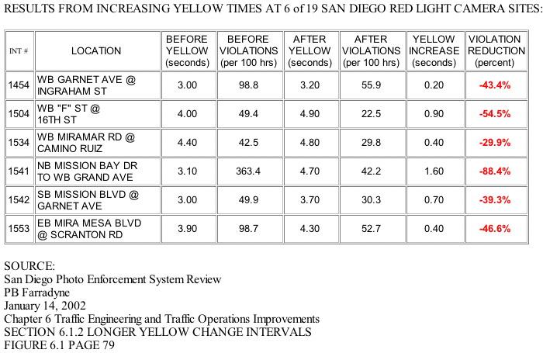
Signal Timing Critical Small Yellow Increases = Large Safety Improvements/Compliance
www.bhspi.org

Slide 17
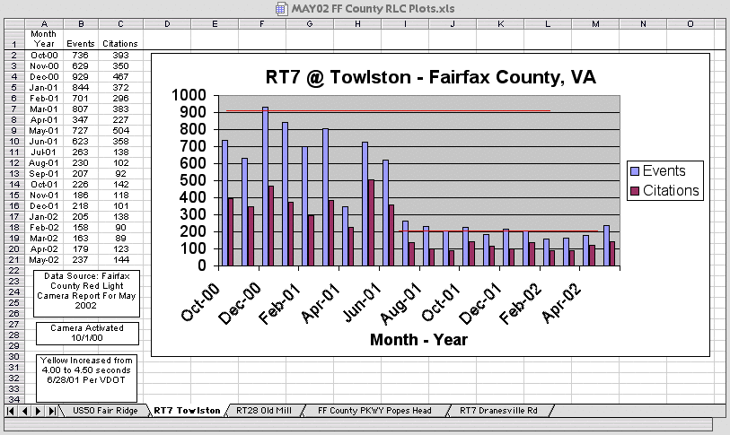
.5 second Increase in Yellow: Dramatically Increased Safety and Compliance - With NO Rebound!
www.bhspi.org

Slide 18
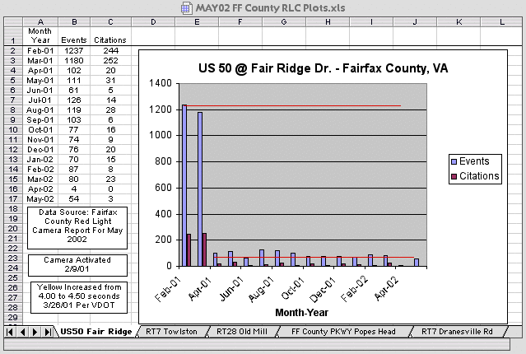
.5 Second Increase in Yellow: Dramatically Increased Safety and Compliance - With NO Rebound!
www.bhspi.org

Slide 19
Camera Installations/Studies Document Engineering Practices Failure
It’s interesting to note that every pro camera study that has been examined in detail, none have survived peer review.
NONE of the camera installations remain after engineering remedies are implemented to meet the safety needs of traffic. NONE! In fact, virtually every contract has sustained red light running minimum thresholds that if the entity doesn’t meet them, or if safety measures are implemented or the conviction rates drop, it violates the contract.
Worse yet, even though the cameras have clearly documented the safety benefits from engineering solutions (yellow interval increases et al), in every case those vested in the cameras success decry these safety/compliance results are anomalies, and have refused to further adjust timing or try it at the other locations.
www.bhspi.org

Slide 20
Camera Installations/Studies Document Engineering Practices Failure
In this regard the National Motorists Association posted a $10,000 dollar challenge to any camera location to apply the known engineering safety countermeasures to improve both compliance and safety. Not a single city took the challenge.
Therefore only one conclusion can be made. The camera operators and their clients are profiting from unsafe practices. This is not safety, it’s revenue at its worst. These short yellows cause significant numbers of unnecessary injuries and deaths and there is no reason whatsoever not to correct this, except money.
Studies show 80 percent of the citation revenue is generated in the first second after the yellow interval change and in every camera location the yellow interval is greater than one second too short. Moreover, the yellow is only the time it takes to stop or proceed from the limit line, and does not include the time it takes to actually clear an intersection.
www.bhspi.org

Slide 21
When and Where did we go from Best Practices to a Revenue, at the Expense of Safety, System?
Here are the prior best practices that were based on fully vetted empirical research.
"The primary measure of effectiveness for the yellow interval is the percent of vehicles entering the intersection after the termination of the yellow indication; that is, during the red following the yellow." ...... "When the percent of vehicles that are last through the intersection which enter on red exceeds that which is locally acceptable (many agencies use a value of one to three percent), the yellow interval should be lengthened until the percentage conforms to local standards."
["Determining Vehicle Change Intervals - A Proposed Recommended Practice", Institute of Transportation Engineers, Washington, D.C., 1985, page 6] The local standard was defined as 1 to 3 percent non compliance…] (to meet 97th to 99th percentile of traffic’s need)
www.bhspi.org

Slide 22
When and Where did we go from Best Practices to a Revenue, at the Expense of Safety, System?
The change in the law that permitted public safety to be trumped by known unsafe practices, empire building and revenue opportunities for NHTSA’s constituents (enforcement industry) et al, and the enterprises and entities that benefit from these policies.
The hijacking of best practices:
1994 - "The preparatory activities of the Automated Enforcement Program, which began in 1994, were supported by seed money from the National Highway Traffic Safety Administration (NHTSA)..." [ http://www.nhtsa.dot.gov/people/outreach/safedige/Spring1998/n5-58.html]
"The new Automated Enforcement Program is designed to be self-supporting through the payment of fines for red light violations.”
www.bhspi.org

Slide 23
When and Where did we go from Best Practices to a Revenue, at the Expense of Safety, System?
The wording that permitted unsafe practices to prevail over public safety!
August 1994 ... as NHTSA and others were underway with their "preparatory activities” to drive their new national red light camera scheme:
"A primary measure of effectiveness for the yellow change interval is the percentage of vehicles entering the intersection after the termination of the yellow indication - that is, during the red following the yellow." ...... "When the percentage of vehicles that entered on a red indication exceeds that which is locally acceptable, the yellow change interval may be lengthened (or shortened) until the percentage conforms to local standards, or enforcement can be used instead." ["Determining Vehicle Signal Change and Clearance Intervals - An Informational Report", Institute of Transportation Engineers, Washington, D.C., August 1994, page 5] for red light violations.”
www.bhspi.org

Slide 24
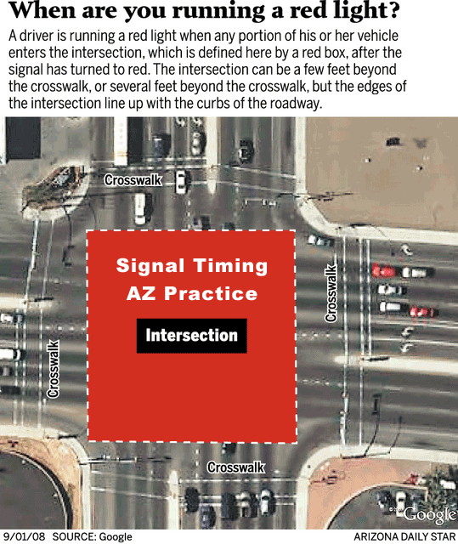
To further foreshorten the yellow, many are now illegally moving the enforcement line!
www.bhspi.org

Slide 25
Solution: Engineering
“Red-Light Cameras Should Not Replace Sound Traffic Engineering,” AAA Says .
"Although some local jurisdictions are looking at red-light cameras as the quick fix, it is not always the most effective means of reducing crashes at intersections," said Susan G. Pikrallidas, vice president of AAA Public Affairs.
According to safety analyses conducted by AAA Michigan, implementation of various engineering safety countermeasures other than red-light cameras have resulted in significant decreases in intersection crashes. (on average greater than 50% reduction)
www.bhspi.org

Slide 26
Solution: Engineering
There is a statistical curve of probability around the average time a driver needs to respond to a yellow signal, and the goal is to make sure that virtually ALL of the curve is accommodated before the opposing signal turns green (97th-99th percentile). Using the all red as the safety cushion.
The kinematic formula is the tool for doing this; it’s only a MODEL of real-world response. It does not CONTROL driver response. If it takes 6 seconds to get all the traffic stopped, including heavy vehicles, buses with standees, old people, distracted drivers, drivers with poor vision, in all lighting conditions, then that is what it takes, and there's nothing anyone can do about it.
The engineer only has one duty, to make sure the traffic control devices are set to safely manage and guide traffic to meet the traffic’s requirements.
www.bhspi.org

Slide 27
Solution: Engineering
Engineers know that the majority of motorists act in a reasonable and responsible manner and that uniformity in expectations improves safety. Using this thesis a researcher found that a 5.5 second yellow interval default setting provides the best overall compliance.
If compliance can be maintained within engineering practices it should be.
If safety were truly the end game here, the answer would be an inverse protocol of procedures for yellow interval timing. The best system wide uniform yellow setting should be a 5.5 second default, except for prevailing speeds in excess of 50 mph where it must be 6 seconds, with a minimum 0.5 second all red grace period, and longer as indicated.
www.bhspi.org

Slide 28
Solution: Engineering
For improved system efficiency, yellow interval timing should only be reduced to whatever level compliance can be maintained.
The yellow interval is for the time it takes a vehicle to proceed or stop at the entrance to the intersection and includes no time to clear it.
Thus the all-red phase must be adequate in length to assure that all conflicting traffic is held until even the slow moving large vehicles can clear the intersection’s conflict points before cross traffic is given a green.
For safety, fair laws, less pollution and more efficiency out of our roadways, engineering will always be the best solution for all. There are no substitutes or short cuts.
Best Highway Safety Practices Institute
Dedicated to the Common Good, Fact Based Standards and Laws..
www.bhspi.org

