Slide 1
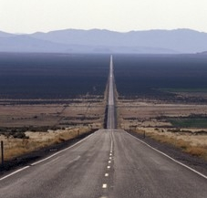
SPEED LIMITS When and why the 85th percentile, how it relates to safety, enforcement and our laws.
Institute of Transportation Engineers
2009 District 6 Annual Meeting
July 12 –15, 2009, Denver, CO
Chad Dornsife, Executive Director
Best Highway Safety Practices Institute
www.bhspi.org

Slide 2
SPEED LIMITS When, Why, How & the Law
Speed limits and the law
Speed limits, speeds and accident risk
Speed limits, who decides and how
Speed limits, who influences policy
Design speed v posted limits
Speed limits, why fact based is important
Recommended practice
www.bhspi.org

Slide 3
SPEED LIMIT SIGN - LAW Traffic Control / Law of the Land
All Acts SHALL be Uniform – Treated the Same
Article 1 Section 8 of the Constitution’s mandate is uniform oversight of regulation of the nation’s roadways (post roads), and the ‘U’ in MUTCD and the UVC is Uniform
In the U.S. and its territories there are 80,000 posting authorities and about 4 million miles of roads, how would a person know what is expected of them, or the penalties as they go from sign to sign, currently they can’t; because the FHWA refuses to enforces its own standards or Congress’ mandates or assure that its standards are promulgated and the posting authorities substantially conform to the Constitution’s due process protections our nation’s Rule of Law mandates.
Safety and due process of law is unachievable without fact based standards and practices that are uniform in application, expectation and the exercise of police powers thereof as you travel from sign to sign.
www.bhspi.org

Slide 4
SPEED LIMIT SIGN - LAW Federally Regulated Device
Unique Application of Federal Supremacy
A Speed Limit Sign is a federal device, MUTCD 2B.13 (R2-1), which a posting authority is authorized to use providing they comply with the the Law of the Land; the U.S. Constitution, Congress’ intent in this field, Title 23 and its MUTCD et al, Supremacy, Commerce and Equal Protection Clause(s), the1st, 4th, 5th, 6th, 9th and 14th Amendment protections thereof regarding the exercise of police powers enforcing federally regulated devices.
www.bhspi.org

Slide 5
SPEED LIMIT SIGN - LAW Federally Regulated Device
Unique Application of Federal Supremacy
Speed Limit Sign (R2-1): Not only is the shape, size, color, placement, hardware, reflective backing quality and the breakaway post design set by federal regulations, the practices and procedures to determine the safety value of the number on the sign and the exercise of police powers thereof SHALL also be fact based and uniformly applied regardless of state lines, entity type or classification on any public or private roadway, pedestrian facility or bikeway open to the public within the U.S. and its territories.
www.bhspi.org

Slide 6
SPEED LIMIT SIGN - LAW Federally Regulated Device
Unique Application of Federal Supremacy
Federal law holds that for safety and due process to be served, the local engineers who have responsibility for traffic control must perform a comprehensive engineering study (safety audit) reviewing each roadway to assure traffic control meets the needs of traffic; and
Because the probable cause for a traffic stop turns on the range of safe speeds indentified in the study for that particular section of roadway, this safe for conditions range must also be quantified; and
It SHALL be documented, and that all decisions thereon are based on this finding of fact, applying their licensed profession’s nationally recognized best practices; and
www.bhspi.org

Slide 7
SPEED LIMIT SIGN - LAW Federally Regulated Device
Unique Application of Federal Supremacy
In this comprehensive finding the engineer is directed to outline all the prescribed remedies that could accomplish optimum safety/compliance, including the number to post if it has been determined to be warranted; and
then the roadway’s regulatory authority, can chose which of the authorized remedies to adopt.
It is the duty of the regulatory authority to codify it per the conditions precedent and protections of the Law of the Land, to give it the force of law.
www.bhspi.org

Slide 8
SPEED LIMIT – LAW Must Be Fact Based
Speed limits are not required by federal law
If found to be warranted, 85th percentile speed to be primary consideration.
Safety value of number posted shall be fact based, with uniform application, practice and expectation in the U.S. and its territories.
Method to determine safety value: Comprehensive traffic engineering study (safety audit) of particular roadway being regulated, supervised by a licensed traffic engineer applying nationally accepted and vetted practices, to be periodically reviewed (5 years or change in conditions on the particular roadway), and it shall be documented.
www.bhspi.org

Slide 9
SPEED LIMIT - LAW Fact Based / One Expectation
There is little traffic engineers can do about this, but it’s something that you should know.
Despite the fact the FHWA purportedly approved statutory and absolute limits in recent MUTCD changes, these uses are clearly in conflict with governing federal law, illegal, and such arguments are prevailing in court.
Statutory Limits UVC §11-802: By definition are not fact based, invented values per local whim/decree, which are also irreconcilable with the U.S. Constitution, Equal Protection Clause, and Congress’ one nation, standard and expectation mandate; as well traffic control based on invented values is irrefutably known to be unsafe practice.
Absolute Limits: Ipso facto, the authority for statutory and absolute limits was repealed for surface streets per the fact based uniformity mandate in the 1988 MUTCD, exception, NMSL postings, and Congress’ repealed that authority in 1995.
Per our based in fact one national standard and expectation – all regulatory speed limits are now recommend maximum prevailing speed, where an unsafe act turns on a speed in excess of the safe for condition then present, not the posted per se – Basic Speed Rule UVC § 11-801.
www.bhspi.org

Slide 10
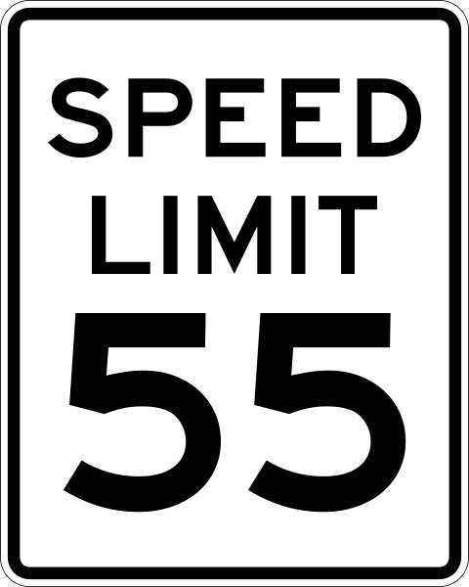
SPEED LIMIT – LAW Fact Based / One Expectation
Post for Recommended Maximum Prevailing Speed:
There can only be one meaning, application and expectation for a R2-1 device
Basic Speed Law trumps posted and there can only be one standard that meets all safety and legal requirements of a speed limit’s expectation
No one speed value can represent the safe for all conditions speed
Basic Speed Law UVC § 11-801, regardless of number posted, speed in excess can be considered safe if conditions then present support it
Post for prevailing conditions
Check against traps
Enforcement officer must be familiar with engineering study for that particular section of roadway to know what the appropriate safe for conditions ranges are, by time of day etc.

Slide 11
SAFEST SPEED What We Know – Engineering Tenet
Mathew C Sielski, ITE President, 1950’s speech to engineers about their responsibilities in establishing proper and realistic speed limits.
One of the most important responsibilities of traffic engineers is the establishment of proper and realistic speed limits. Our profession has long recognized that most citizens will behave in a reasonable manner as they go about their daily activities.
Thus, traffic laws that are based upon behavior of reasonable motorist are found to be successful. Laws that arbitrarily restrict the majority of motorist encourage wholesale violations, lack of public support, and usually fail to bring about desirable changes in driving behavior. This is especially true of speed limits”.
Our profession, since the early 30’s, based its speed zoning techniques on several concepts deeply rooted in our American system of government and law, namely:
1. Driving behavior is an extension of our social attitude, and the majority of drivers respond in a safe and reasonable manner, as demonstrated by their good driving records.
2. The careful and competent actions of a reasonable person should be considered legal.
3. Laws are established for the protection of the public and the regulation of unreasonable behavior of an individual.
4. Laws cannot be effectively enforced without the consent and voluntary compliance of the public majority.”
www.bhspi.org

Slide 12
SAFEST SPEED What We Know – Engineering Tenet
Mathew C Sielski, ITE President, 1950’s speech to engineers about their responsibilities in establishing proper and realistic speed limits.
Our profession also recognizes that an emotionally aroused public will reject these fundamentals and will rely on more comfortable and widely held misconceptions, such as:
1. Speed limit signs will slow the speed of traffic.
2. Speed limit signs will decrease accidents and increase safety.
3. Raising a posted speed limit will cause an increase in the speed of traffic.
4. Any posted speed limit must be safer than an unposted speed limit, regardless of the prevailing traffic and roadway conditions.
Before and after studies have proven conclusively that these are definitely misconceptions. Unfortunately, in too many instances influential pressures succeed in the application of such unrealistic regulations.
www.bhspi.org

Slide 13
SAFEST SPEED What We Know
The challenge is articulated here in a NCHRP discussion of design, operating and posted limits.
2003 NCHRP Report 504 reports a new factor.
"To an open-ended question," respondent engineers placed "politics" way above the engineering factors as the number one reason for "deviation" from the 85 percentile operating speed.
With this political reality of "politics" controlling sound engineering traffic engineering studies, compliance with the MUTCD becomes impossible.”
Since 1992, engineering studies and the 85th percentile speed as the primary criteria for traffic control and setting speed limits has been under direct attack within the USDOT, with a concerted effort to dilute or displace these engineering tenets. Incredibly, in 2003, the USDOT made this NCHRP 504 statement a per se fait accompli when they codified proscribed non conforming local political whim as superior to Congress’ uniform national traffic control standard mandate!
www.bhspi.org

Slide 14
SAFEST SPEED What We Know
Nebraska Department of Road, NDOR
University of Nebraska Lincoln,
Department of Civil Engineering College of Engineering and Technology:
Research Report No. TRP-02-26-92
Evaluation of Lower Speed Limits on Urban Highways:
“SAFETY EFFECTS
The results of the analysis of the accident experience in speed zones indicate that zones with posted speed limits equal to the reasonable speed limits proposed by the NDOT method of speed zoning are safer than zones posted with limits that are 5 and 10 mph below the reasonable speed limits. Speed zones with speed limits 5 mph below the reasonable speed limits were found to have 5 percent more accidents than zones with reasonable speed limits. Speed zones with speed limits 10 mph below the reasonable speed limits were found to have 10 percent more accidents than zones with reasonable speed limits. Therefore, the speed zones on state highways in urban areas should be posted with reasonable speed limits proposed by NDOR method in order to minimize the numbers of accidents in the speed zones. Speed limits lower than the reasonable speed limits should not be posted.”
www.bhspi.org

Slide 15
SAFEST SPEED What We Know
AASHTO
A 1969 “Resolution of the annual meeting of the American Association of State Highway Officials”
“The review of existing practices revealed that most of the member departments use, primarily, the 85th percentile speed. Some agencies use the 90th percentile speed, and of secondary consideration are such factors as design speed, geometric characteristics, accident experience, test run speed, pace, traffic volumes, development along the roadway, frequency of intersections, etc.”
“On the basis of the forgoing review, the Subcommittee on Speed Zoning recommends to the AASHTO Operating Committee on Traffic for consideration as an AASHTO Policy on Speed Zoning that:
The 85th percentile speed is to be given primary consideration in speed zones below 50 miles per hour, and the 90th percentile speed is to be given primary consideration in establishing speed zones of 50 miles per hour or above. To achieve the optimum in safety, it is desirable to secure a speed distribution with a skewness index approaching unity”
www.bhspi.org

Slide 16
SAFEST SPEED What We Know
Federal Highway Administration
Report No. FHWA/RD-85/096 Technical Summary, "Synthesis of Speed Zoning Practice" which states:
"Based on the best available evidence, the speed limit should be set at the speed driven by 85 to 90 percent of the free-moving vehicles rounded up to the next 5 mph increment. This method results in speed limits that are not only acceptable to a majority of the motorist, but also fall within the speed range where accident risk is lowest.”
“No other factors need to be considered since they are reflected in the drivers speed choice.”
www.bhspi.org

Slide 17
SAFEST SPEED What We Know
Institute Of Transportation Engineers; (urban highways)
ITE Committee 4M-25, Speed Zone Guidelines:
“Thus, the overriding basis (from a safety perspective) for speed zoning should be that the creation of the zone, and the speed limit posted, results in an increase in the percentage of motorists driving at or near the 85th percentile speed.”
“A third rationale is the need for consistency between the speed limit and other traffic control devices. Signal timing and sight distance requirements, for example, are based on the prevailing speed. If these values are based on a speed limit that does not reflect the prevailing speed of traffic, safety may be compromised.”
“2. The speed limit within a speed zone shall be set at the nearest 5 mph increment to the 85th percentile of free flowing traffic or the upper limit of the pace of the 10 mph pace.” “In no case should the speed limit be set below the 67th percentile speed of free flowing traffic.”
www.bhspi.org

Slide 18
SAFEST SPEED What We Know
Chapter 8, California State Traffic Manual:
“Speed limits established on the basis of the 85th percentile conform to the consensus of those who drive highways as to what speed is reasonable and prudent, and are not dependant on the judgement of one or a few.”
Chapter 8, California State Traffic Manual: (continued)
“Further studies have shown that establishing a speed limit at less than the 85th percentile (Critical Speed) generally results in an increase in accident rates.”
Washington State DOT website:
"people don't automatically drive faster when the speed limit is raised, speed limit signs will not automatically decrease accident rates nor increase safety, and highways with posted speed limits are not necessarily safer than highways without posted limits.
www.bhspi.org

Slide 19
SAFEST SPEED Free Flowing
What is the safe speed and who decides?
The core tenet of reasonable traffic laws, safety and due process is that the super majority of people act in a safe and responsible manner, and they do drive safely for the conditions present. The engineering study quantifies the range of “super majority’s” reasonable and prudent consensus for that particular section of roadway, rather than relying on the judgment of one or a few.
Urban roadways – 85th percentile speed
Urban, 50 mph plus 85th – 90th percentile speed
Rural 2 lanes* – mean plus 8 mph
Urban freeways* – mean plus 12 mph, higher speeds low risk
Rural low volume roadways – higher speeds low risk
Rural Interstates – higher speeds low risk
*Relative risk bell curve skewed by methodology, hypothesis and legacy environments of studies. Engineering practices, roadway environment and motorists’ flow expectations are the primary safety prognosticator, not the number on sign.
www.bhspi.org

Slide 20
SAFEST SPEED Accident Risk in Built Up Areas
14
12
10
8
6
4
2
0
5
15
50
85
95
100
Percentile Speed
Source: FHWA Office of Safety and Traffic Operations R&D
www.bhspi.org

Slide 21
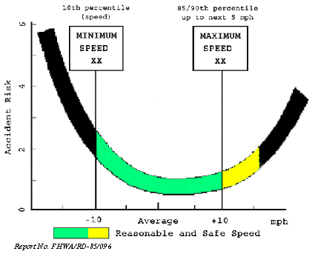
SAFEST SPEED Accident Risk in Built Up Areas
Source: FHWA Office of Safety and Traffic Operations R&D
www.bhspi.org

Slide 22
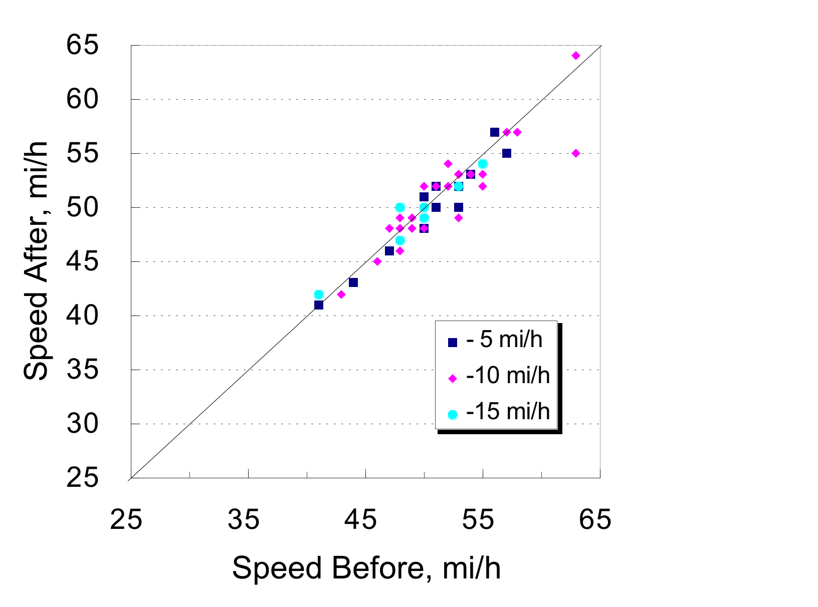
SAFEST SPEED Built Up Areas – Lowering Limit
Doesn’t slow traffic
Source: FHWA Office of Safety and Traffic Operations R&D
www.bhspi.org

Slide 23
SAFEST SPEED Built Up Areas – Raising Limits
Has little effect on speeds
Source: FHWA Office of Safety and Traffic Operations R&D
www.bhspi.org

Slide 24
SAFEST SPEED Built Up Areas – Behavior Doesn’t Change
5
4
3
Maximum
Increase
2
Average
Change
1
0
Change in 85th Percentile Speed, mi/h
-1
-2
-3
Maximum
Decrease
-4
-5
-15 & -20
-10
-5
+5
+10 & +15
Change in Posted Speed Limit, mi/h
Source: FHWA Office of Safety and Traffic Operations R&D
www.bhspi.org

Slide 25
SAFEST SPEED Accident Risk in Built Up Areas
Before & After – Raising to 85th is safest
50
40
Upper Estimate
30
+27.5
20
Best Estimate
10
+6.9
mean
+5.3
0
Percent Change in Crashes
mean
-11.3
-10
-10.4
-20
-30
Lower Estimate
-25.2
-40
-50
Lowering Speed Limit
Raising Speed Limit
Source: FHWA Office of Safety and Traffic Operations R&D
www.bhspi.org

Slide 26
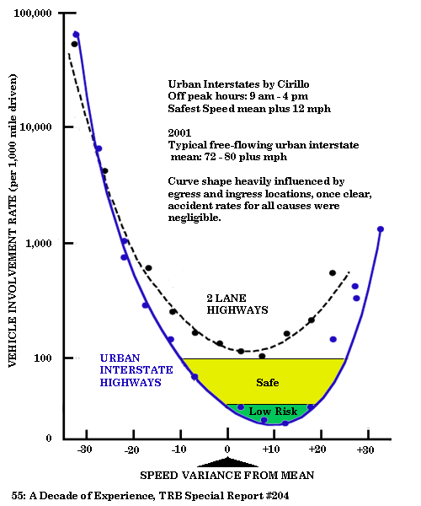
SAFEST SPEED Limited Access
Shape of 2 lane highway risk curve heavily influenced by vehicle mix and engineering practices circa 1960’s. Notwithstanding, Solomon's methodology was far superior and remains unique in this field, because he used actual travel speeds prior to and at time of incident, and causations. The predominantly 1950’s vehicles in his study were underpowered, required significant distances for overtaking, and passing exclusion zones etc were non existent. This is no longer the case and risk are much lower, except for slow moving vehicles.
In all cases, once clear of conflict zones and hazards, risk from speed in and of itself is low.
FHWA 1991: Only one in ten limits are posted at or greater than the mean, and in all cases the safest speeds are greater than the posted limits, is still applicable.
www.bhspi.org

Slide 27
SAFEST SPEED Limited Access - No Daytime Limits
What Happens when you have no daytime speed limits outside of the city limits, on every classification of roadway, paved or otherwise? Nothing!
Montana: Summary of the effects of no daytime speed limits
Fatal accident rates on highways studied reached an all time low in modern times.
On 2 lane highways multiple vehicle accidents dropped 5 percent.
Seat belt usage went up to 91% percent in 1999, with only a secondary enforcement law.
www.bhspi.org

Slide 28
SAFEST SPEED Montana No Daytime Limits
Traffic speeds did not significantly change and remained consistent with other western states with like conditions. Motorists continued to drive at speeds they were comfortable with.
Note: 7 years after arbitrary numeric speed limits were reinstated, 85th percentile speeds remained within 1 mph - Great Falls monitoring site
The theory behind posting speed limits on these classifications of highways is to reduce conflicts in traffic flow caused by speed differential, thereby reducing accidents.
With the expectation of higher speed differentials, multiple vehicle accident rates declined even though the actual speeds did not change significantly.
This suggests the improvements were the result of positive motorists behavior changes; courtesy and due caution, not speed limits or differential regulation.
www.bhspi.org

Slide 29
SAFEST SPEED Montana No Daytime Limits
After the reinstatement of limits, what can be said for sure is there was no positive correlation between speed enforcement and accident rates on rural free flowing highways, if anything, the highways became less safe, and motorists behavior became less courteous again.
MONTANA PARADOX: Is that the desired safety effect from posting speed limits was achieved by removing them.
www.bhspi.org

Slide 30
SAFEST SPEED Montana No Daytime Limits
Fatal Accident Summary*
Source Montana DOT
Interstate Primary Total
'94 41 70 111
'95 33 72 105
'96 39 75 114
'97 51 91 140
'98 31 82 113
'99 30 72 102
Last 12 Months, through mid ‘99
With No Daytime Limits
27 74 101 Low
‘00 After Speed Limits Reinstated
56 87 143 High
Montana: percentage of daytime accidents involving multiple vehicles
Interstate Primary
'94 24% 53%
'95 26% 53%
'96 29% 52%
'97 25% 50%
'98 22% 49%
'99 26% 48%
'00 26% 50%
Fall 95 – mid 99 no daytime speed limits
Last 6 months of no limits, no enforcement
(enforcement ruled unconstitutional)
After limits were reinstated 2 lane multiple vehicle accidents increased 2 percent after a 5 year downtrend
*Montana Paradox Study, 6 years of data. Each roadway classification was tracked using the same criteria: location, time, vehicle, single or multiple, cause, twilight, daytime. night, and it was collected independent of Montana’s statewide FARS reports.
www.bhspi.org

Slide 31
SAFEST SPEED Montana No Daytime Limits
Montana’s speed limit reinstatement in the summer of 1999 had no factual foundation whatsoever from an engineering perspective; despite the many studies undertaken by the Montana Office of Traffic Safety that unsuccessfully attempted to attribute higher speeds with higher incident rates; fatal and multiple vehicle accidents were at an all time modern low.
Remarkable anecdote: In the 6 years of working with the Montana DOT gathering this data, there was always the big paradox – not one fatality was brought to our attention that was attributed to no daytime speed limits!
www.bhspi.org

Slide 32
SAFEST SPEED Montana No Daytime Limits
Montana gave us a contemporary real world validation that roads with maximum speed limits are not safer than those without limits; with a 4 year data set of no daytime limits that included every roadway outside of a city limit, paved or unpaved, in an entire state.
A speed limit sign is a safety device that must first have a demonstrated need per the MUTCD to be warranted.
If posted speed limits demonstrated no safety value, then where is the factual foundation required by law to post or enforcement them.
What we know is speeds did not change appreciably, but without limits there were positive behavioral changes and accident levels reductions.
www.bhspi.org

Slide 33
SAFEST SPEED Montana No Daytime Limits
The Montana Paradox safety results were not an anomaly.
“Up until 2007, rural roads in the Northern Territory, Australia had no speed limit. Claiming that speed limits were essential to saving lives, the state government imposed a 130km/h (80 MPH) limit on the Stuart, Arnhem, Victoria and Barkly highways and a 110km/h (68 MPH) speed limit on all other roads, unless otherwise marked lower.”
Here are the results:
Year 2002 2003 2004 2005 2006 2007 2008
Fatalities 55 53 35 55 44 57 75
A 50% increase in road deaths after the introduction of the speed kills policy, cameras and draconian regulation. The same type of spike Montana experienced.
http://www.roadsense.com.au/facts.html
www.bhspi.org

Slide 34
SAFEST SPEED Montana No Daytime Limits
In Nevada when we looked at fatal accidents on rural highways, well in excess of 70 percent of them were single vehicle events, with fatigue, sleep deficit and medical problems etc being the leading probable cause. When someone is driving in their comfort zone, they are at their safest. Forcing them drive outside of their comfort zone increases stress, fatigue etc. If you add a half hour or more to their travel time, their exposure goes up exponentially for the greatest risk factors. The problem isn’t speed, it’s the per se lack of it.
Driving slower and arbitrary traffic regulations does not equate to safety: Urban roadways posted at the 85th percentile speed are safer than those that are under posted. Now we can add Montana to the Autobahn’s and Australia's former no limit roadways; that roadways without speed limits are among the safest of them of all.
www.bhspi.org

Slide 35
SAFEST SPEED Why Findings and Practice are Inconsistent
Politics, power and empires is the short answer.
When the science of traffic safety became a threat to the status quo of NHTSA in the early 90’s, the USDOT ceased all new research that could possibly come to any conclusion contrary to their agendas or supporting constituent’s self-interest.
Then USDOT disbanded and or subjugated the FHWA safety teams and researchers, changed the way data was reported, including FARS causations, spent hundreds of millions to reinforce their public safety myths with new faux research and position papers.
www.bhspi.org

Slide 36
SAFEST SPEED Why Findings and Practice are Inconsistent
NHTSA then sponsored misinformation efforts to discredit and dilute the influence of engineering practices. The following in part describes the nature and rational for this after the Martin Parker study (Effects of Raising and Lowering Speed Limits on Safety) was first circulated in 1991, and held from publication until the author changed the conclusion in 1995, to conform.
1995 Federal Register (NHTSA comment):
“The agencies have not adopted West Virginia's suggestion to include a statement that enforcement funding be preceded by engineering evaluations of existing speed limits. To do so would hinder enforcement efforts, based on a blanket presumption that existing speed limits are not reasonable. The agencies are neither willing to accept that presumption nor to place conditions on enforcement efforts, which we view as a vital tool for effective speed control.”
Thus, for more than a decade the USDOT reference base in this field has been severely compromised and is incredible, including the source content of TRB Special Report 254 and USLIMITS
(Details, timelines and events available upon request)
www.bhspi.org

Slide 37
SAFEST SPEED Why Findings and Practice are Inconsistent
After the repeal of the NMSL, NHTSA’s legacy of 25 years and hundreds of thousands dependant on enforcing the NMSL needed new justification for their very existence. To meet this crisis for the agency and its constituents, NHTSA hired an ad agency to invent new traffic offenses, justifications and slogans, including zero tolerance.
Remember NHTSA’s strong objection to properly engineered speed limits? Well compare its newly invented zero tolerance threshold to what NHTSA actually knew in 1995, when the USDOT subjugated the FHWA research group that authored the following;
Samuel C. Tignor and Davey Warren. "Driver Speed Behavior on U.S. Streets and Highways." Institute of Transportation Engineers: 1990 Compendium of Technical Papers, PUB# PP-020 (FHWA and AASHTO)
“It would be premature to draw any firm conclusions since the research is still underway. However the findings to date suggest that, on average, current speed limits are set too low to be accepted as reasonable by the vast majority of the drivers. Only about 1 in 10 speed zones has better than 50 percent compliance. The posted limits make technical violators out of motorists driving at reasonable and safe speeds.
For the traffic law system to minimize accident risk, then speed limits need to be properly set to define maximum safe speed. Our studies show that most speed zones are posted 8 to 12 mi/h below the prevailing travel speed and 15 mi/h or more below the maximum safe speed. Increasing speed limits to more realistic levels will not result in higher speeds but would increase voluntary compliance and target enforcement at the occasional violator and high risk driver.
www.bhspi.org

Slide 38
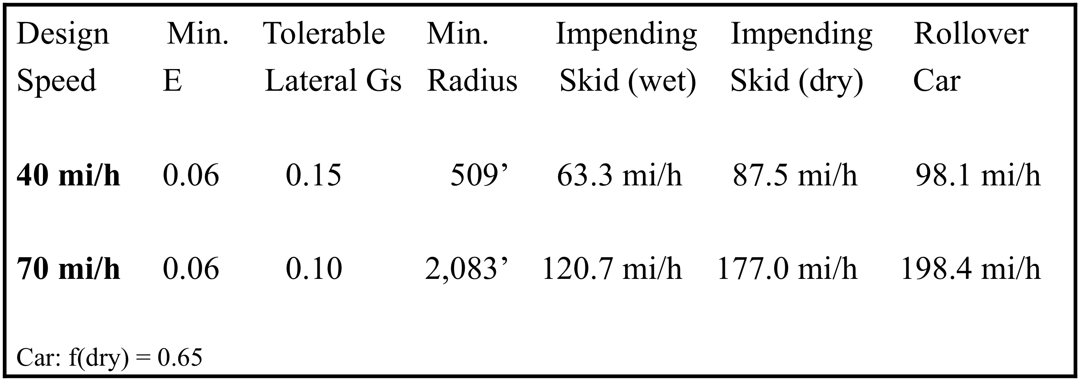
DESIGN vs OPERATING SPEED Curves - Comfort Circa 1940’s
Eisenhower's 70 mph Interstate System – The 70 mph design speed was a comfort standard with low Gs for an unrestrained passenger sitting blindfolded on a 1940’s circa vehicle front bench seat.
Source: FHWA-RD-89-226
www.bhspi.org

Slide 39
DESIGN vs OPERATING SPEED Minimum Design Speed
All geometric elements must meet or exceed
Only when constrained by terrain or development is minimum used
Maximum safe speed for worst driver under bad road conditions
Reaction time of drunk drivers, stopping with bald tires on slippery road, average comfort level of blindfolded passengers in 1930 vintage car
Driver, environment, vehicle and roadway characteristics govern the operating speed
Minimum design speed should be based on functional classification, rural vs urban, terrain, volume and anticipated operating speed based on studies from like facilities
www.bhspi.org

Slide 40
RECOMMENDED PRACTICE What We’ve Learned
Speed limits require factual foundation
Roadways with limits are not necessarily safer than roads without them
Speed limit sign is a federal device and its application must be uniform
Most speed limits set unreasonably low
Make technical violators out of large percent of motorists driving at safe speed
Current speed limits do not reflect accident risk
Inconsistent with traffic law system
Misallocates enforcement resources
Most motorists drive at a speed road and traffic permits regardless of posted speed
Don’t automatically drive 5, 10 or 15 mph over limit
After as few as 6 days, more than 50 percent of the super majority are found in the top 15th percentile speeds and 100 percent of the measured traffic speeds can still be within safe for conditions
Speed limits have lost their informational value, and with it any positive influence they could have upon safety
www.bhspi.org

Slide 41
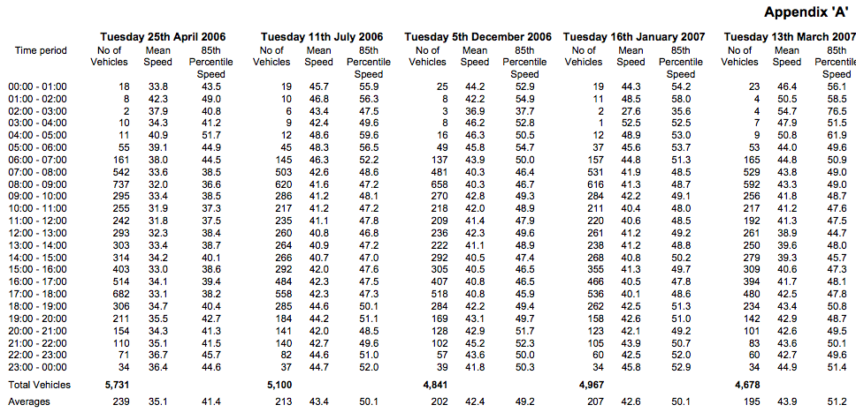
RECOMMENDED PRACTICE Spot Survey Inadequate
Speed of traffic best indicator of reasonable and safe speed
Spot speed survey does not meet due process or safety requirements of a study
Typical speed varies 4-8 miles per hour over 24hr day
Speed variance can be even greater by day, and time of year
Safe speed can vary more than 30 mph – sample of such a site – what would you post?
www.bhspi.org

Slide 42
RECOMMENDED PRACTICE Speed Study Factors
Must be 24 hour free-flowing speeds
Measuring all vehicles in queues results in a lower than actual speed distribution
Vehicles entering or leaving the stream shall be excluded
At least 500 feet from junctions, convergence zones and curves
No active enforcement prior to or during study
Measurement methods must not impede traffic or influence results
Radar devices have shown to result in 3 mph plus reduction in speed - "Detectible” measurements methods influence results
Measurement cosine angles greater than 15 degrees results not reliable
New roadway surface increases speed 4-5 mph
Trucks on average are 3 mph slower
Prevailing speed - 85th percentile speed rounded up to next 5 mph
Higher speeds are found where higher speeds are safe
Highest speed roadways safest
Study must quantify entire range of safe speeds which can include all vehicles
Every 5 years or when there is a substantive change in use
www.bhspi.org

Slide 43
RECOMMENDED PRACTICE Interstate and Rural Highways
Requires study to determine need justified, if warranted;
Post recommended maximum prevailing
24 hour free-flowing speeds
85th percentile speed rounded up to next 5mph
Minimize zone changes over contiguous sections
No other considerations
Regardless if posted or not:
Representative data points and periodic safety audits (5 years)
Mitigate hazards with signs, passing exclusion zones etc or remedial action based on prevailing speed
SPEED
LIMIT
85
PERCENTILE
www.bhspi.org

Slide 44
RECOMMENDED PRACTICE Urban Roadways & Arterials
Post recommended maximum prevailing
24 hour free-flowing speeds
85th percentile speed rounded up to next 5mph
Minimize zone changes over contiguous sections
½ mile intervals data points and periodic safety audits (5 years)
Mitigate hazards with signs, access & parking restrictions or remedial action
No other considerations
SPEED
LIMIT
85
PERCENTILE
www.bhspi.org

Slide 45
RECOMMENDED PRACTICE Residential Areas / Business Parks
Post recommended maximum prevailing
24 hour free-flowing speeds
85th percentile speed rounded down to next 5mph
Representative samples
If lower limits desired, change environment, use roundabouts where practical
Mitigate hazards with signs, access & parking restrictions or remedial action
Do not use stop signs for speed control
SPEED
LIMIT
85
PERCENTILE
www.bhspi.org

Slide 46
RECOMMENDED PRACTICE School Zones
Prima facie
Create traffic plan
Minimize cross traffic
Average speed measured when children present
Children present defined as 15 to 30 minutes before and after school hours
Children are not considered present during school hours if school has secure perimeter or is set back from roadway or school is 9-12 grades
SPEED
LIMIT
50
PERCENTILE
www.bhspi.org

Slide 47
RECOMMENDED PRACTICE Work Zones
Prima facie
Average speed during good conditions
Stabilize flow and reduce chaos prior to hazard
Only in effect when hazard or workers present
Vary limits as conditions change
Use warning sign for hidden hazards and guidance; post advisory speed at average speed of traffic when hazard exists
SPEED
LIMIT
50
PERCENTILE
www.bhspi.org

Slide 48
RECOMMENDED PRACTICE Truck Speed Limits
Post recommended maximum prevailing
Maximize flow harmony
Not to exceed 75 mph*
Set regulatory limits to meet special needs on grades etc.
Restrict or designate lane use when applicable
Use truck characteristic based warning signs for hidden hazards & post advisory speeds to meet their needs
SPEED
LIMIT
85
PERCENTILE
*UTAH, rural I-15 test section posted 80 mph - 24 hrs, harmonized car and truck speed limit. Observation: traffic flow remarkably harmonized, calm and orderly!
www.bhspi.org

Slide 49
RECOMMENDED PRACTICE Conclusion
The speed of traffic is self-regulating. The number on the sign has no appreciable effect on average speeds or 85th percentile speeds, but it can affect behavior and improve flow management, resulting in fewer flow conflicts and lower accident rates.
Whereas under posted limits result in greater flow friction and conflicts, to the detriment of safety.
Roadway design and environment determine safety and travel speeds, not the number on the sign. More importantly, a road with a posted limit is not necessarily safer than a road without posted limits and 100 percent of the traffic in a study could still be within the safe for conditions speed.
Traffic calming has it own short comings and many treatments can increase accidents, reduce roadway capacity, increase air pollution and lose their novelty effect as those that use the roadway daily return the speeds they are comfortable with.
www.bhspi.org

Slide 50
RECOMMENDED PRACTICE Conclusion
Flow conflict points are where the majority of preventable accidents occur; examine all locations as to remedies to reduce flow friction, minimize cross movements, and improve guidance.
Minimum speed limits have been shown to reduce dangerous overtaking and accident rates.
“Keep Right Except to Pass” needs to be emphasized, and dedicated lanes need to be built on grades for slow moving vehicles because slow vehicles represent a clear and present danger.
Safety is found in flow management and assuring that motorists are informed in a timely manner as to the conditions ahead, exits et al and or hazards – for the speeds they are driving!
Regulatory speed limits should not be used for hazards, curves, intersections etc; hazard signs are to be used to clearly describe the nature of the risk ahead with appropriate advisory speed, relative to the prevailing approach speeds.
www.bhspi.org

Slide 51
RECOMMENDED PRACTICE Conclusion
Roadway environment and hazard mitigation is the most effective way to reduce fatalities and serious injuries.
The number one contributing cause for those driving extended distances is fatigue, sleep deficit and complications from medical problems, therefore improving the acceptance and use of rest areas is a critical public safety strategy.
The truth is of those accidents that are preventable, engineering solutions represent the only true solutions because you cannot correct a design deficiency with enforcement. If there is a problem area, then the engineer needs to act on it to determine what is contributing to the problem, what remedies may be indicated to correct it, and then place it on the action list accordingly.
Placing an invented number on a sign will not make you safer, but fact based laws that are uniformly applied, and making sure best safety practices are followed will.
www.bhspi.org

